Slide 1

3D Ray Tracing Engine
with Interactive GUI
Abu Bakar, M Shahman Butt
Project Visual Computing
Professor Olivier Staadt
Department of Computer Science, University of Rostock

Slide 2
Presentation Overview
🎯 Core Concepts
• What is Ray Tracing?
• Path Tracing Algorithm
• Monte Carlo Integration
🔧 Implementation
• Materials & BRDFs
• Acceleration Structures
• Interactive GUI
📊 Results
• Performance Metrics
• Sample Renders
• Future Work

Slide 3
Tasks Division
Shahman
Abu Bakar
World Setup & Scene Composition (18 h) :
Parsing the scene input and setting up the objects in the world. Organizing objects in a hittable list for ray-object intersections.
Camera and Mesh Interaction(17 h) :
Setting up the camera and implementing the ray-object intersection logic for meshes.
Material Handling, Ray Tracing(19 h)
Defining material models and simulating light interactions with objects in the scene.
BVH Optimization (15 h):
Organizing the scene into bounding volumes and optimizing
ray tracing with BVH.
UI Integration for Rendering: (20 h)
Building the user interface for controlling the rendering
process and visualizing results.
Optimization - Multi-Threading (15 h) :
Improving rendering speed and implementing additional rendering features like reflections or shadows.

Slide 4
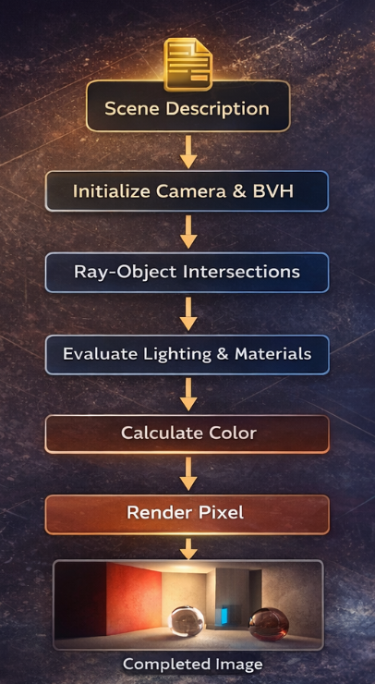
Ray Tracing
Ray tracing simulates the physical behavior of light by tracing light rays as they interact with objects in a 3D scene.
Natural Effects:
Reflections - Mirror-like surfaces
Refractions - Glass and water
Shadows - Both hard and soft
Global Illumination - Indirect lighting

Slide 5
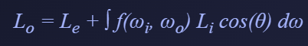
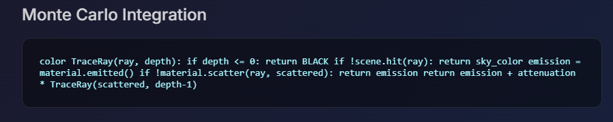
Path Tracing Algorithm
The Rendering Equation:
L_{o} - Outgoing radiance
L_{e} - Emission (lights)
f - BRDF (material reflection)
L_{i} - Incoming radiance

Slide 6
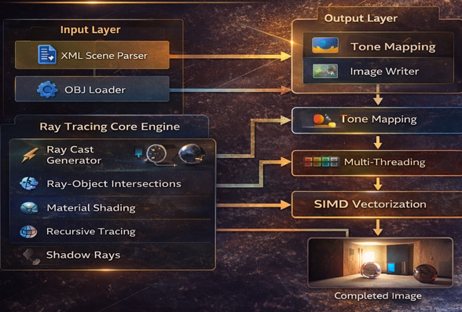
Design & Architecture
Layered architecture, where the input layer parses scene data, the core engine handles ray tracing and material interaction, and the output layer applies optimizations like tone mapping to generate photorealistic images.

Slide 7
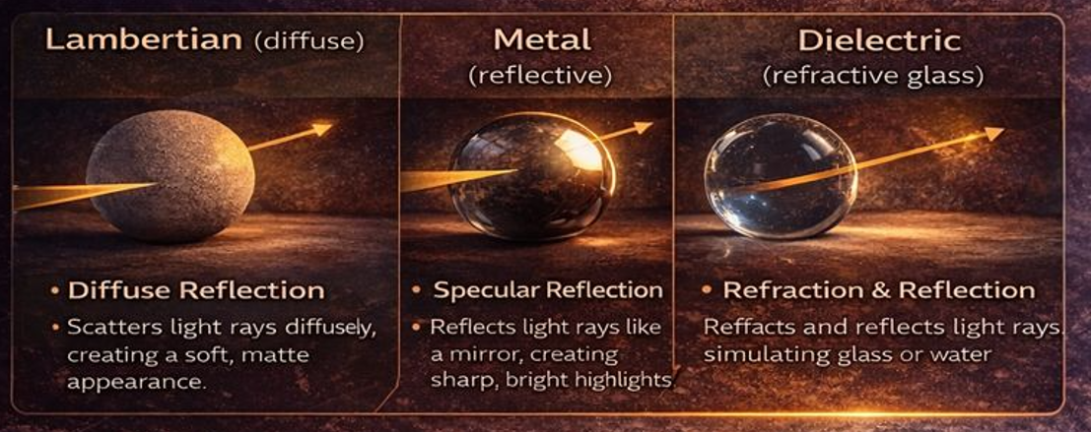
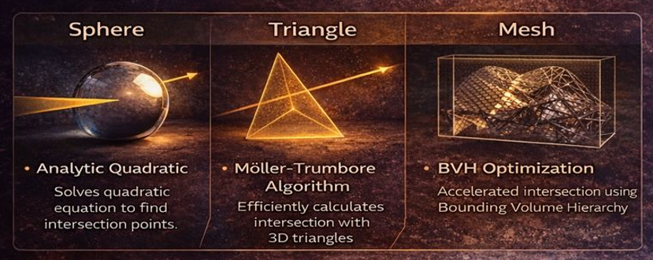
Materials & BRDFs
Lambertian (Diffuse)
Metal (Reflective)
Dielectric (Glass)
"Objects like spheres and meshes are defined by geometric data and materials, tested for intersection with rays to determine visibility and lighting."

Slide 8
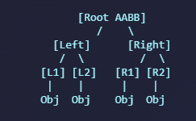
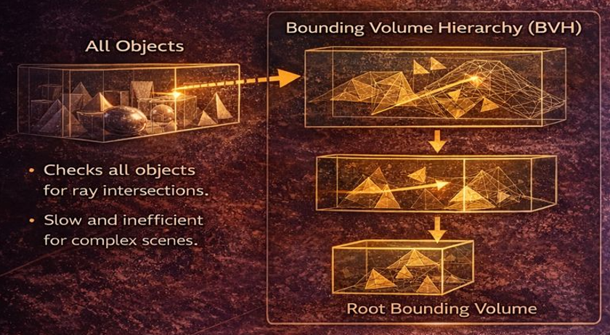
BVH Acceleration
The Problem
Testing every ray against every object is O(n) per ray - too slow for complex scenes with millions of triangles.
The Solution: BVH
Bounding Volume Hierarchy
Tree of Axis-Aligned Bounding Boxes
O(log n) intersection
Surface Area Heuristic for splits

Slide 9




Optimization Techniques
Multi-threading (OpenMP)
Tile-based rendering with dynamic scheduling. Each thread renders independent 32x32 pixel tiles for cache efficiency.
AI Denoising (Intel OIDN)
Machine learning-based denoising produces clean images with far fewer samples. Reduces render time by 10x.

Slide 10
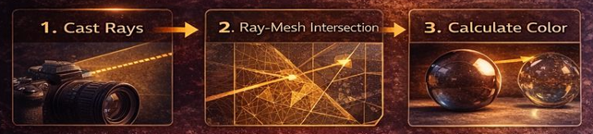
Camera & Mesh Interaction
The camera casts rays through each pixel in the scene, intersecting with meshes to simulate realistic lighting and generate photorealistic images.

Slide 11
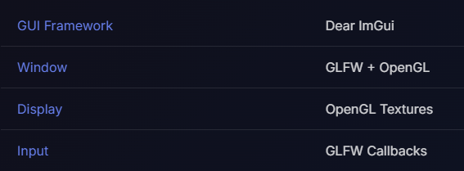
UI
Real-time Preview
Progressive Rendering
Scattered pixel for instant feedback
Camera Controls
WASD movement + mouse look
Dynamic Settings
Adjust resolution, samples, sky colors
Batch Rendering
High-quality output with denoising

Slide 12
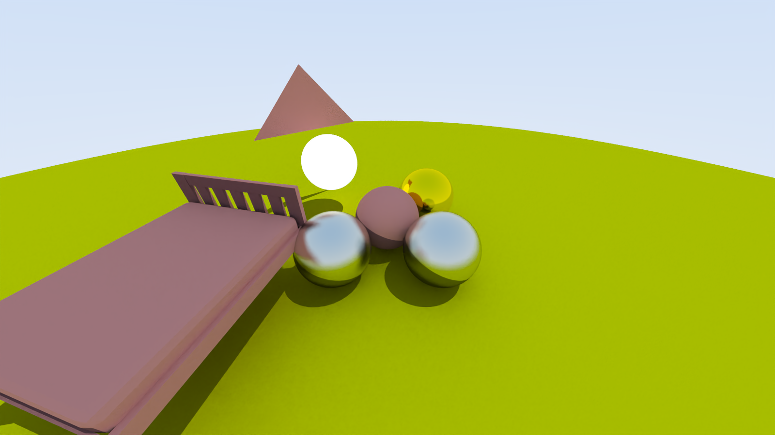
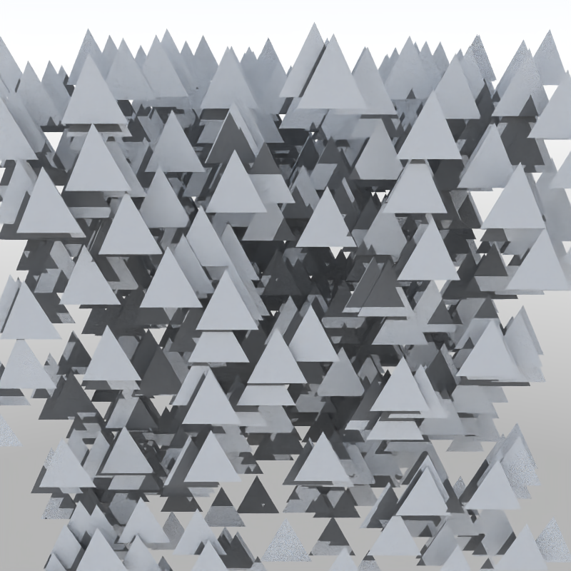
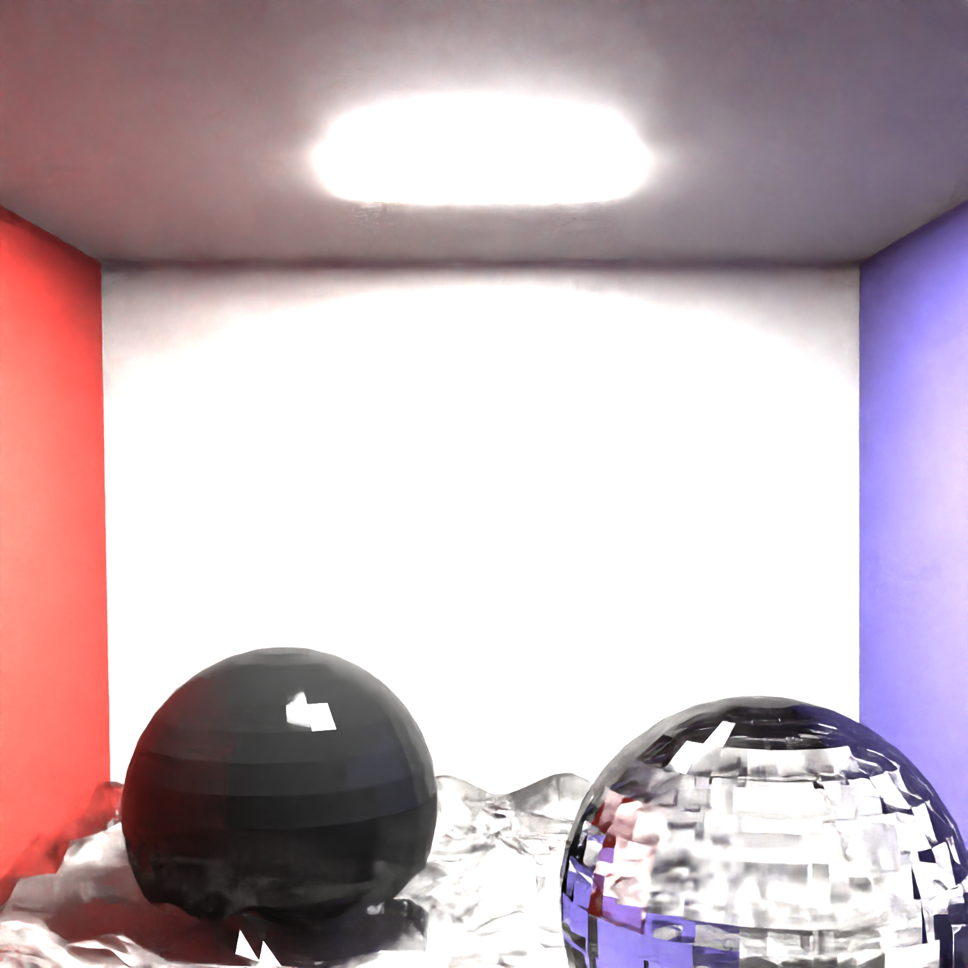
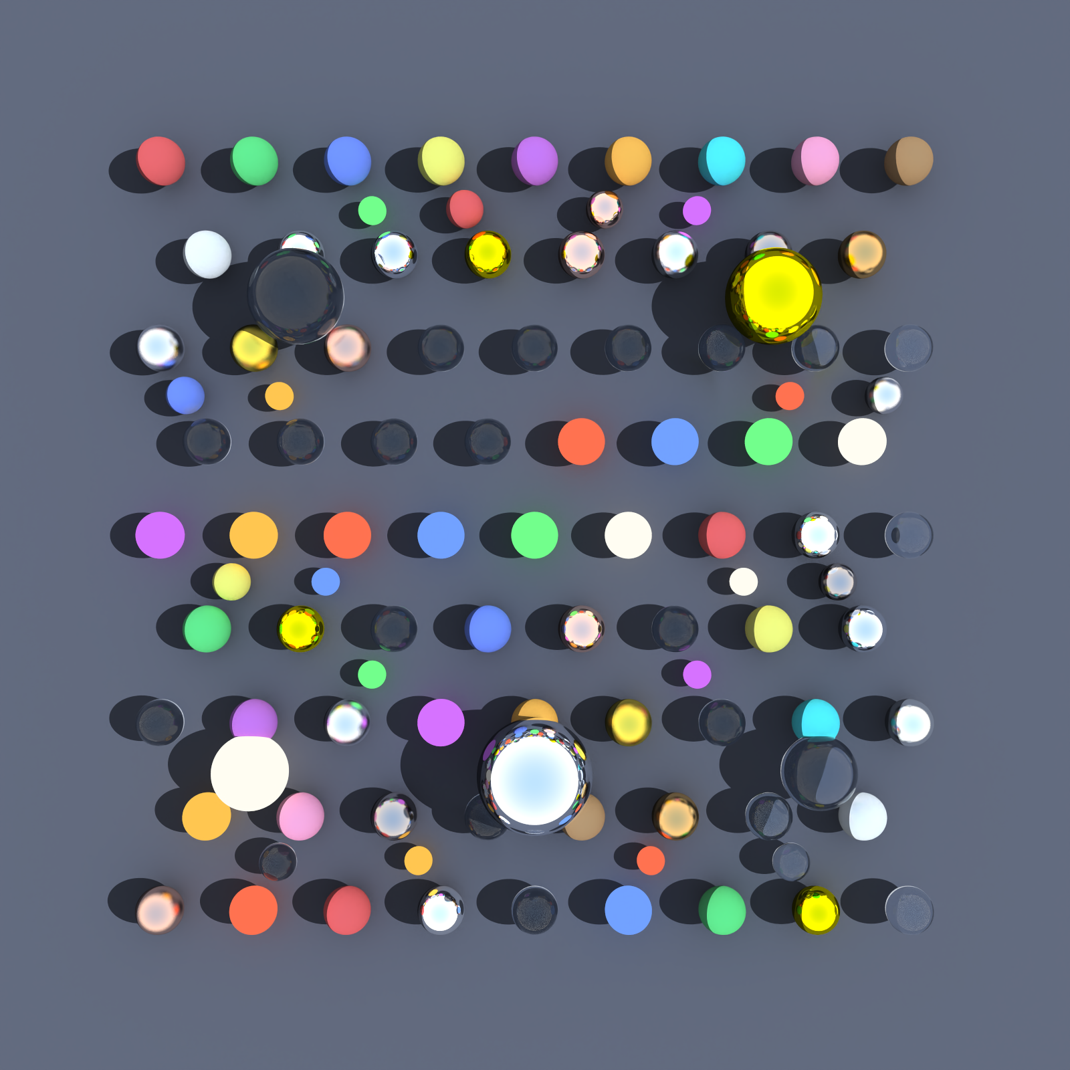
Results
Bed.obj
Thousand_triangles.obj
Cornel_box.obj
Hundred_spheres.obj

Slide 13
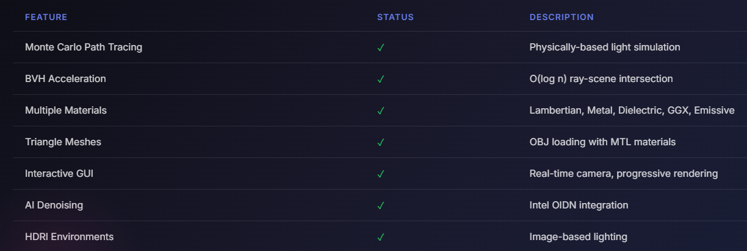
Features Implemented

Slide 14
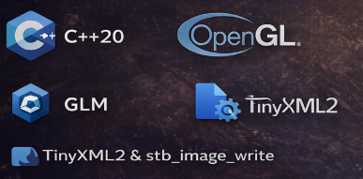
Tools & Technologies
Language
(C++)
High performance, low-level memory control, industry standard
Denoising
(Intel OIDN)
AI-powered image denoising
Scene Format
(XML + OBJ/MTL)
Human-readable scene definitions
Build System
(CMake)
Cross-platform build configurations

Slide 15
Future Work
Performance
Features
GPU Acceleration CUDA/OptiX for 100x speedup
Adaptive Sampling Focus samples on noisy regions
Multiple Importance Sampling Better variance reduction
Bidirectional Path Tracing Better caustics handling
Volumetric Rendering Fog, smoke, clouds
Motion Blur & DoF Temporal and camera effects

Slide 16
Q/A
Thank you for your attention, and we welcome any questions or feedback regarding our 3D Ray Tracing Engine project

